Slide 1

AWS S3 Static website hosting

Slide 2
agenda
Introduction
Walkthrough AWS Console
Services Exploration(S3-Simple Storage Service)
Allowing Permissions
Final Deployment

Slide 3
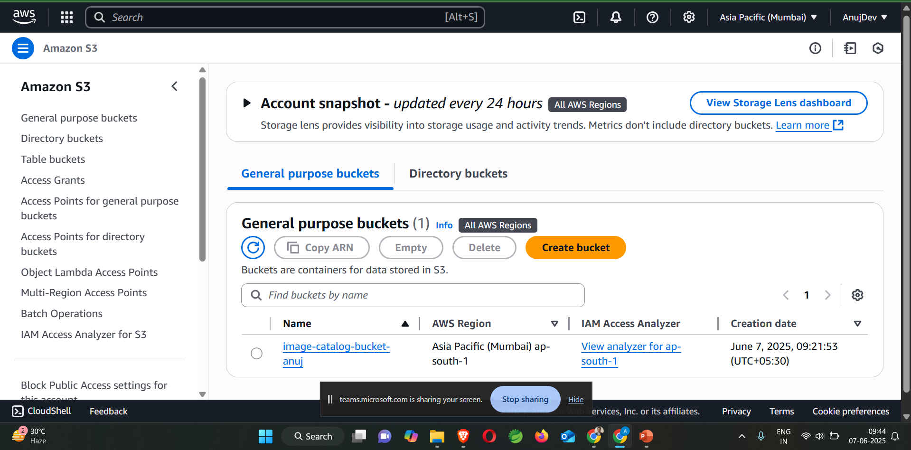


Slide 4



General Configuration Steps 1.Provide Bucket Name 2.Uncheck the block all public access Option 3.Now redirect to Create bucket

Slide 5
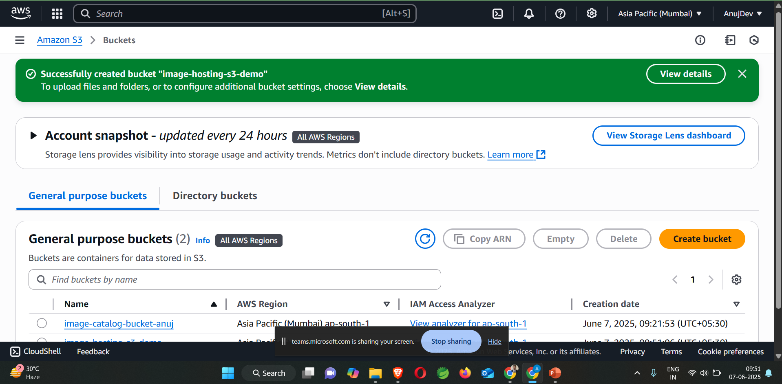

Slide 6

S3 bucket Exploration
AWS S3 bucket Allows you 5GB Free Tier Storage within the stipulated timeframe.
Presentation is showcasing to just host a static website not the fancy one just for simulating how aws services works.

Slide 7
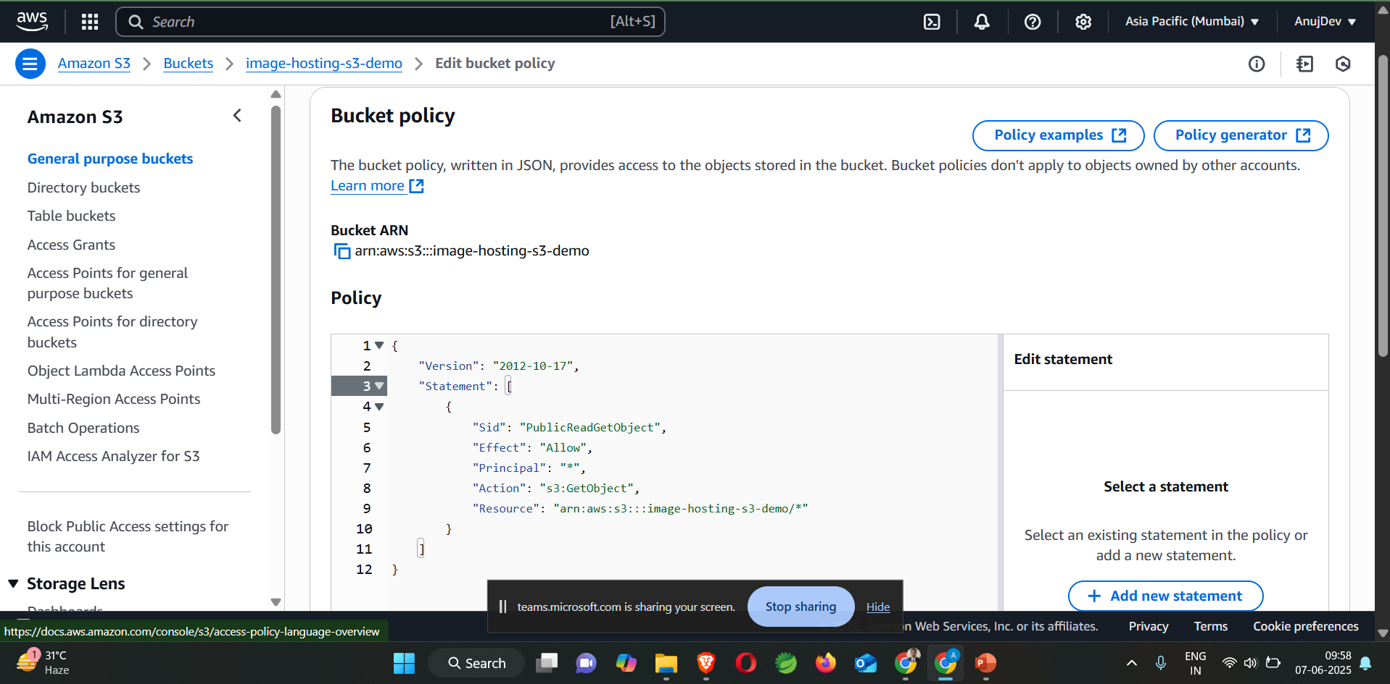
Creating Bucket Policy via input JSON to specify details

Slide 8
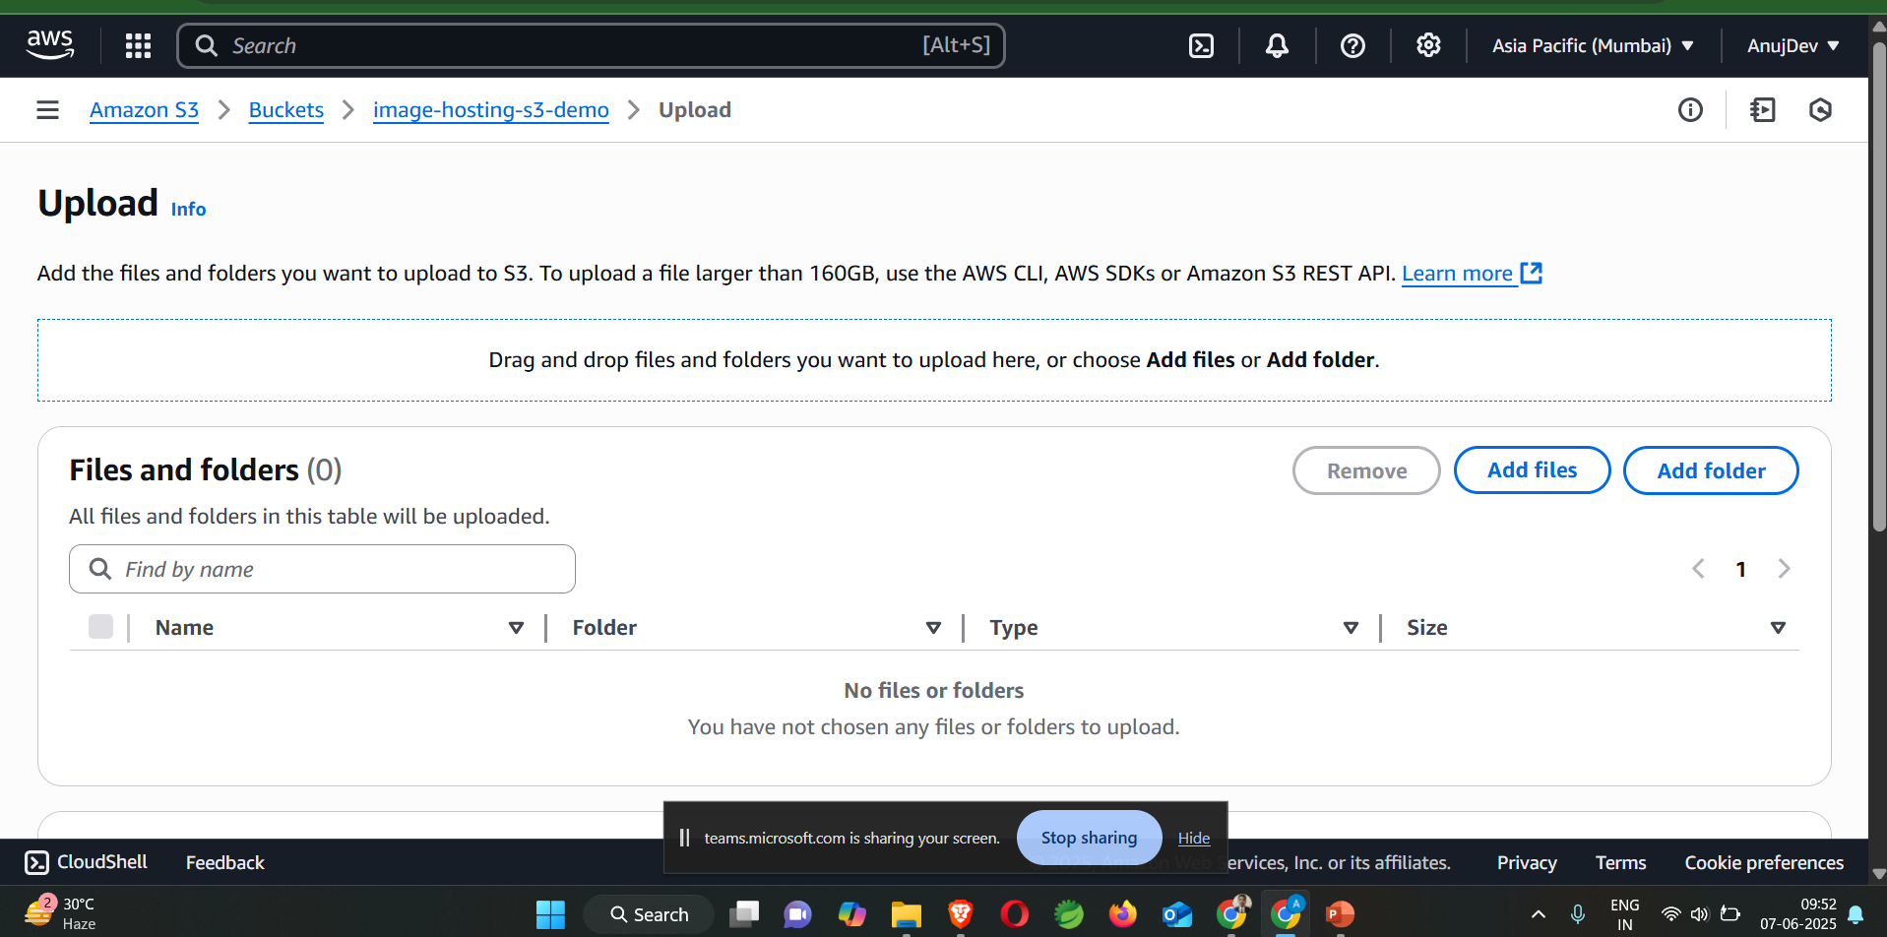

Slide 9
Major checks
User need to explore services and walkthrough and Each and every steps should be done carefully
After Creating S3 Bucket make sure you have allowed permissions if you want to access from any device.
Then input the JSON file into Bucket Policy so that it will not throw 403 Forbidden Error or 404 Not Found.(Major Check)
After that go to S3 Bucket and there is Object URL try to access
https://image-hosting-s3-demo.s3.ap-south-1.amazonaws.com/index.html
Now you have hosted your static Website in Remote Storage(S3 without any domain hosting and necessities).

Slide 10
Final tips & takeaways
Overview how to access AWS console
Service Exploration S3
Hosted Static Website on S3 Bucket
S3 buckets store Raw data and in Object form
Aim for stop the service like instance because in the
Backend services will still work and cost you Bills.
Its Reliable and Easy to use and most Popular Data Storage AWS Service.
Storage and Management
Object Versioning
Object Replication
Storage Classes
Free Tier Limitation

Slide 11

Understanding Hacker News: A Simple Guide
This presentation introduces Hacker News, your gateway to the latest in technology, startups, and insightful discussions. Learn how to maximize your engagement and explore this unique online community.

Slide 12




What is Hacker News?
Community-Driven
Y Combinator
Intellectual Curiosity
Founded by Paul Graham, it is operated by the startup accelerator Y Combinator.
Hacker News is a platform for link aggregation and discussion, powered by its community.
The site focuses on computer science, entrepreneurship, and anything intellectually stimulating.

Slide 13
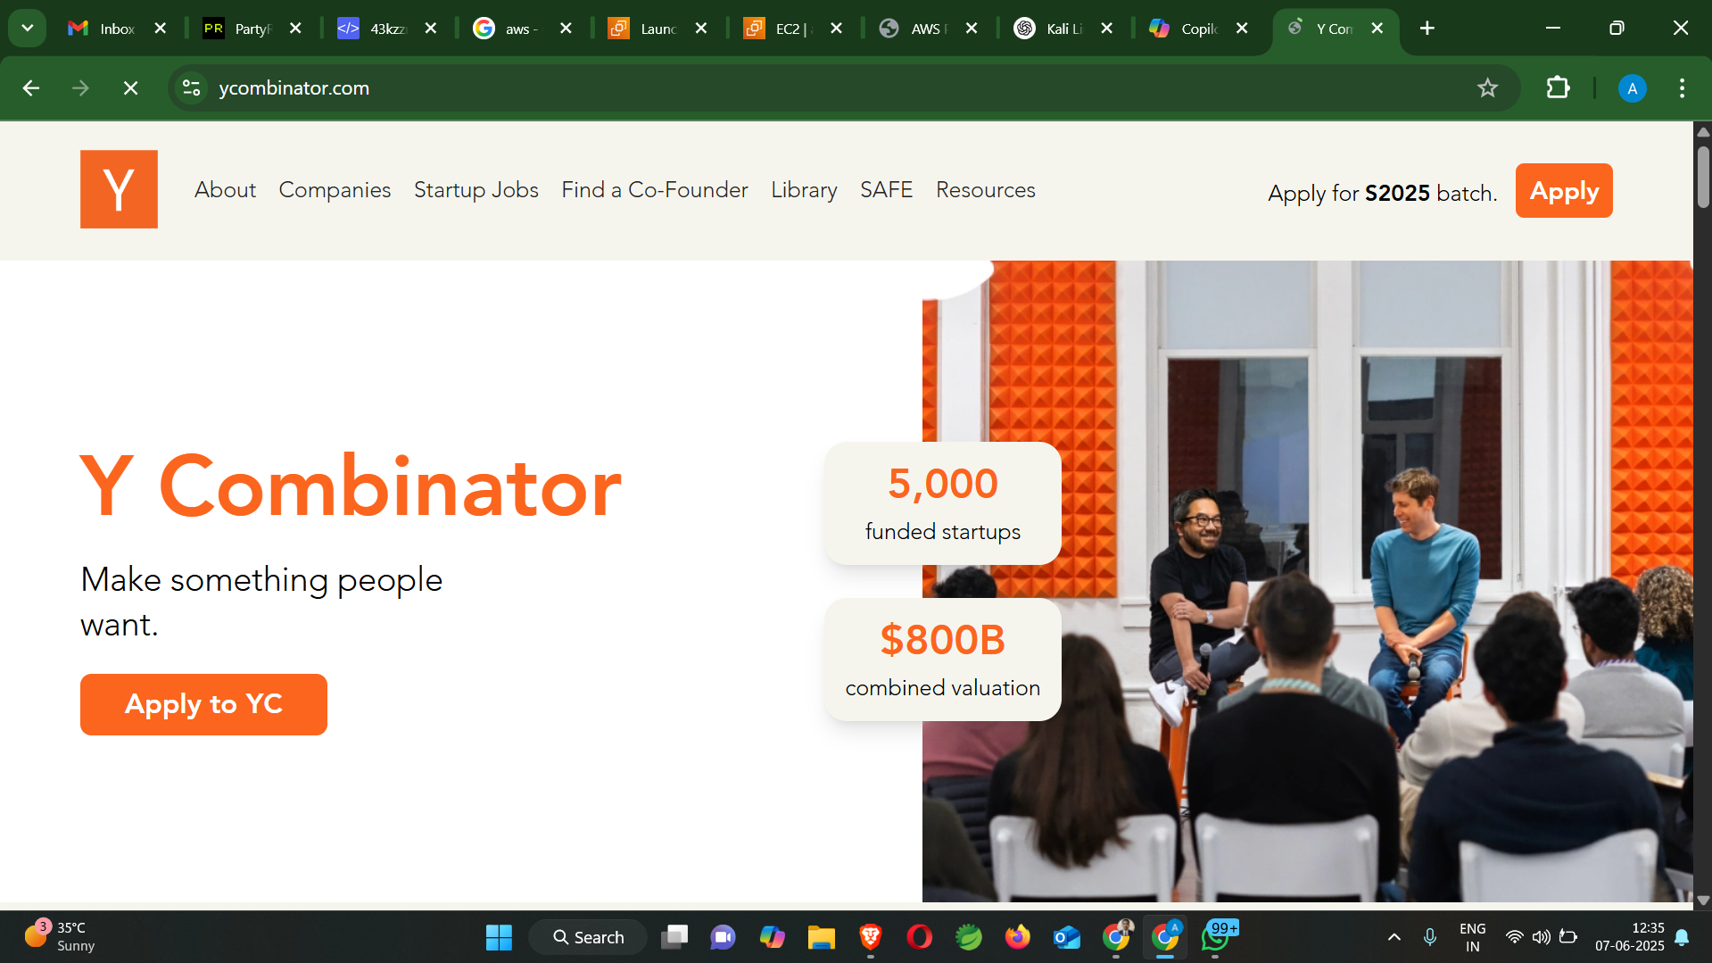

Slide 14

What Kind of Content is on Hacker News?
Tech & Insight
Projects & Code
Broad Discussions
Discover news articles, blog posts, and essays, often highly technical and future-oriented.
Showcase and discuss source code repositories from platforms like GitHub.
Engage in conversations spanning economics, politics, and culture.

Slide 15




The Hacker News Community
Thoughtful Discussion
Active Moderation
Karma System
The community prides itself on civil and constructive conversations.
Moderators work to maintain high-quality discussions and prevent spam.
Users earn "karma" points for positive contributions and engaging content.

Slide 16

How to Engage Effectively
Read the guidelines: understand quality submissions and avoid voting rings.
Write clear, concise, and respectful comments that add value.
Contribute positively to foster a healthy community environment.
Avoid sensationalism and clickbait in titles for better engagement.

Slide 17








Advanced Tips and Tricks
Algolia Search
Follow Users
Use Algolia to quickly search the entire Hacker News archive.
Follow specific users to discover curated content and discussions.
Keyboard Shortcuts
Browser Extensions
Utilize keyboard shortcuts for faster navigation and interaction.
Enhance your browsing experience with various useful extensions.

Slide 18

Conclusion
Valuable Resource
Hacker News is an indispensable platform for tech enthusiasts and innovators.
Stay Informed
Keep up with cutting-edge trends and contribute meaningful insights.
Join the Community
Embrace the spirit of learning and thoughtful discussion. Welcome!

Slide 19
Thank you
28811 – Anuj Sen
Contact – anujdev@example.com
9999999999

